Slide 1
BEER MIDDLE SCHOOL
Course Selections
2022 - 2023

Slide 2
Seventh Grade

Slide 3

Seventh Grade
REQUIRED ACADEMIC COURSES
40 WEEKS EACH
Language Arts – 2 HOUR BLOCK
Math Course 2 or Math Course 3 by placement
Science 7
Social Studies 7

Slide 4


Seventh Grade
ELECTIVE COURSES
40 Weeks Total
OPTION 1: Band for 40 weeks.
OPTION 2: Two 20-week electives.

Slide 5
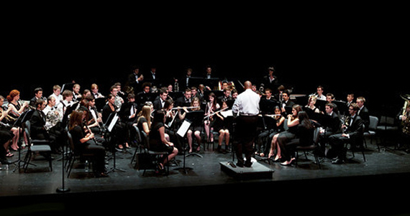
CADET BAND – 40 WEEKS
For students who have completed one year of Band.
Further development of skills toward mastery of their instrument.
Performance attendance and activity participation is required.

Slide 6

2-Dimensional Art – 20 WEEKS
Introduces elements and principles of art through history and culture.
Two-Dimensional Art forms will be explored.
  Pencil and pastel drawing
  Acrylic and watercolor painting
  Printmaking
  Silk painting
Same class offered in 8th grade

Slide 7

3-Dimensional Art – 20 WEEKS
Introduces elements and principles of art through history, society, and culture.
3-Dimensional art forms will be explored in various forms.
Same class offered in 8th grade

Slide 8
Engineering and the Environment – 20 WEEKS
Students will engage in hands on activities that utilize their reasoning and problem-solving skills to discover the science behind the technology of alternative, sustainable, and renewable energy sources, including alternative fuels like fuel cell cars, ethanol, bio-fuels, solar, hydro, and wind power.
Offered in 8th grade

Slide 9

Engineering for the Future – 20 WEEKS
In this course, students will discover the science and technology needed to create, design, and manufacture different structures and machines.
Use problem solving to learn about:
  Simple machines
  Bridges
  Skyscrapers
  Robotics
  Rocketry
Offered in 8th grade

Slide 10


CHOIR
20-week class
Vocal technique, sight reading, music theory, and music history
Offered in 7th and 8th grade

Slide 11
Health – 20 Weeks
Students will study physical, mental, and social health.
Areas covered include:
  Communicable disease/AIDS
  Human sexuality
  Personal Care/Fitness/Nutrition
  First Aid/Safety
  Public and Environmental Health
  Substance Abuse

Slide 12


Emerging Technologies I
Essential Skills covered in this class are:
  Basic Orientation
  Typing Skills
  Digital Footprint
  Troubleshooting
  Cyber Safety
  Microsoft Imagine Academy
Offered in 7th and 8th grade

Slide 13

Emerging Technologies II
Essential Skills covered in this class are:
  Digital Citizenship
  Typing Skills
  Interactive Technologies
  Communicating Digitally
  Read World Ready
  Microsoft Imagine Academy
Offered in 7th and 8th grade and must have taken Emerging Tech I before taking this class.

Slide 14


Introduction to Coding
Essential Skills covered in this class are:
  Introduction to coding and computer science
  Cyber Safety
  Accountability
  Efficiency within the field of coding and computer science
Offered in 7th and 8th grade
Highly recommend taking Emerging Technologies 1 and Emerging Technologies 2 before taking this course

Slide 15
Spanish A – 20 Weeks
Only for students who did not take Spanish A in 6th grade.
This course, with a Mexican cultural emphasis, will develop the student’s speaking, reading, and writing of the Spanish Language.

Slide 16

Spanish B – 20 WEEKS
Only for students who did not take Spanish B in 6th grade.
This course, with a Latin American/Spanish cultural emphasis, will develop the student’s speaking, reading, and writing of the Spanish Language.

Slide 17
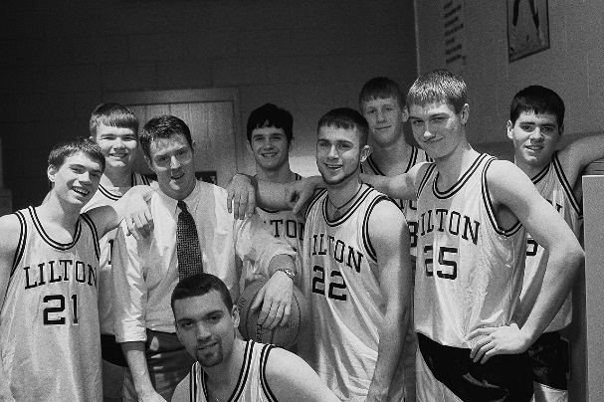
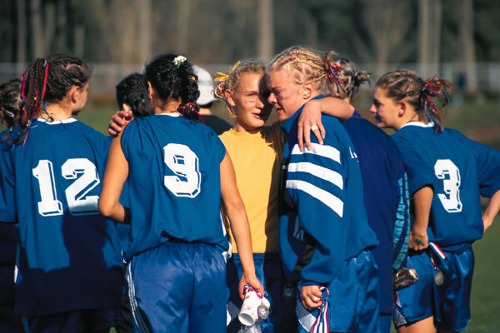
Team Sports – 20 WEEKS
This course focuses on categories of sport and activity, progress in motor skills and tactical knowledge unique to that category of physical activity.
Combining basic elements of movement and sports are emphasized in this course.
Similar course required in 8th grade called Fitness for Life

Slide 18
IMPORTANT!
You MAY NOT repeat an elective course that you took in 6th grade with the exception of Band and Choir.
Spanish A, Spanish B, and Team Sports are all classes you may have taken this year and you may not repeat them.
Do not choose a repeat course for the next school year.

Slide 19
Seventh Grade
Reading or Math Intervention classes
It may replace one of your elective courses
Placement Test Results
M-Step Scores
NWEA Scores
Academic Grades

Slide 20
You may also apply for MSVPA for next school year at Butcher
For more information click on the below link: http://school.wcskids.net/msvpa/about-us/
MS-WCSPA is intended for academically-focused and creative students who seek to blend their academic experience with interest in the performing arts.
Students who are accepted into the program will split their school day between their home middle school, where they will take their language arts, science and math classes, and Butcher Educational Center, where they will take their social studies and two performing arts electives. The performing arts electives will include visual arts, music, dance, and theatre exploratory experiences.

Slide 21
DUE DATE
Thursday, February 17th to your science teacher

Slide 22
Thank you
for viewing this presentation 7th Graders!

