Slide 1
Scheduling for next school year
Eighth Grade

Slide 2
BEER MIDDLE SCHOOL
Course Selections
2022 - 2023

Slide 3

Eighth Grade
REQUIRED ACADEMIC COURSES
40 WEEKS EACH
Language Arts
Math Course 3 (or Algebra 1
by placement)
Science 8
Social Studies 8
Fitness for Life*

Slide 4

Physical Education Course
Fitness for Life – 20 Weeks
Designed to enable 8th grade students to progress in skill and knowledge related to movement and physical activity.
Appropriate concepts of physical fitness and motor skills are explored.

Slide 5


Eighth Grade
ELECTIVE COURSES
OPTION 1: Band
Fitness for Life
One additional elective
OPTION 2: Spanish 1 (HS Credit)
Fitness for Life
One additional elective
OPTION 3: Three 20-week electives
Fitness for Life
OPTION 4: Spanish 1(HS Credit)
Band

Slide 6
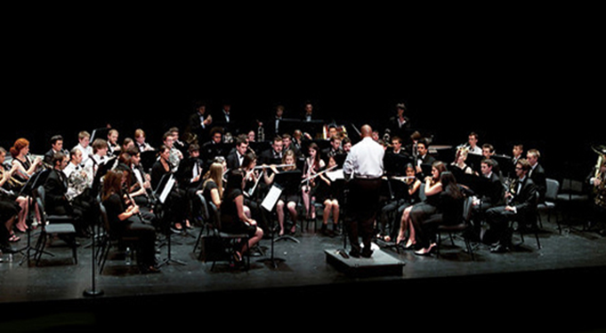
CONCERT BAND – 40 WEEKS
Advanced course of study for players of wind and percussion instruments.
New instrumental techniques and music theories will be learned.
Performance attendance and activity participation is required.

Slide 7

SPANISH 1 – 40 WEEKS
H.S. CREDIT
Concentration on listening to and speaking the target language with the aim of proficiency in Spanish.
Memorization, recitation, and mimic responses are required.
Cultural discussions on beliefs, ideas, and behaviors of Spanish speaking people are held.
Grade does not count on GPA but will appear as credit or no credit on HS transcript.

Slide 8

2-Dimensional Art – 20 WEEKS
Introduces elements and principles of art through history and culture.
Two-Dimensional Art forms will be explored.
  Pencil and pastel drawing
  Acrylic and watercolor painting
  Printmaking
  Silk painting

Slide 9

3-Dimensional Art – 20 WEEKS
Introduces elements and principles of art through history, society, and culture.
3-Dimensional art forms will be explored in various forms.

Slide 10


CHOIR
20-week class
Vocal technique, sight reading, music theory, and music history
Offered to 6th, 7th, and 8th graders

Slide 11
Engineering and the Environment – 20 WEEKS
Students will engage in hands on activities that utilize their reasoning and problem-solving skills to discover the science behind the technology of alternative, sustainable, and renewable energy sources, including alternative fuels like fuel cell cars, ethanol, bio-fuels, solar, hydro, and wind power.

Slide 12

Engineering for the Future – 20 WEEKS
In this course, students will discover the science and technology needed to create, design, and manufacture different structures and machines.
Use problem solving to learn about:
  Simple machines
  Bridges
  Skyscrapers
  Robotics
  Rocketry

Slide 13
Health – 20 Weeks
Students will study physical, mental, and social health.
Areas covered include:
  Communicable disease/AIDS
  Human sexuality
  Personal Care/Fitness/Nutrition
  First Aid/Safety
  Public and Environmental Health
  Substance Abuse

Slide 14


Emerging Technologies I
20 WEEKS
Essential Skills covered in this class are:
  Basic Orientation
  Typing Skills
  Digital Footprint
  Troubleshooting
  Cyber Safety
  Microsoft Imagine Academy

Slide 15

Emerging Technology 2
20 WEEKS
Essential Skills covered in this class are:
  Digital Citizenship
  Typing Skills
  Interactive Technologies
  Communicating Digitally
  Read World Ready
  Microsoft Imagine Academy
You should take Emerging Tech 1 before taking Emerging Technologies 2

Slide 16


Introduction to Coding- 20 Weeks
Essential Skills covered in this class are:
  Introduction to coding and computer science
  Cyber Safety
  Accountability
  Efficiency within the field of coding and computer science

Slide 17
Spanish A – 20 Weeks
Only for students who did not take Spanish A in 6th or 7th grade.
This course, with a Mexican cultural emphasis, will develop the student’s speaking, reading, and writing of the Spanish Language.

Slide 18

Spanish B – 20 WEEKS
Only for students who did not take Spanish B in 6th or 7th Grade.
This course, with a Latin American/Spanish cultural emphasis, will develop the student’s speaking, reading, and writing of the Spanish Language.

Slide 19
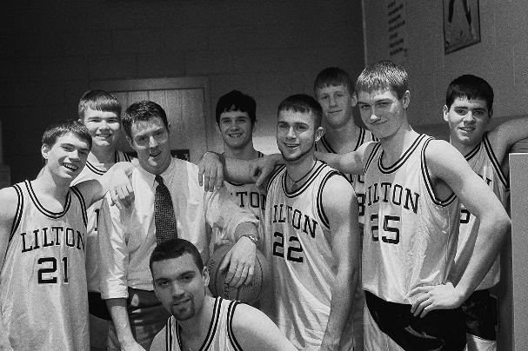
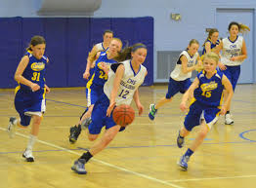
Team Sports – 20 WEEKS
This course focuses on categories of sport and activity, progress in motor skills and tactical knowledge unique to that category of physical activity.
Combining basic elements of movement and sports are emphasized in this course.

Slide 20
Eighth Grade: Required for some students (this would replace 1 elective class).
ELA or Math Intervention
Selection Criteria
Placement test results
M-Step Score
NWEA Test Scores
Language Arts Grades or Math Grades

Slide 21
DUE DATE
Thursday, February 17th to your Science teacher

Slide 22
Thank you for viewing this presentation 7th Graders

