Slide 1
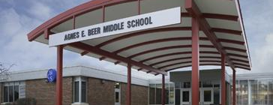
BEER MIDDLE SCHOOL
WELCOME

Slide 2

BEER MIDDLE SCHOOL
MISSION STATEMENT
We are committed to valuing diversity, building relationships and providing an environment that is safe, supportive, and allows students to attain their personal best.

Slide 3
BEER BARON STAFF
Mr. Xavier Whitacre- Principal
Mr. Eric Williamson- Assistant Principal
Ms. Bobbi Pudrith- Counselor (A-Kat)
Mr. Ryan Kay- Counselor (Kat-Z)

Slide 4

How We Communicate
PowerSchool for Academics/Grades
Schoology Individual Teacher Websites and Messages
Monthly Newsletter
Teacher/School Email
Phone
Robo Calls

Slide 5
Request a District Laptop/HotSpot
You can request a WCS Issued Laptop and/or Hotspot by completing the Technology Request Survey
Technology Request Link

Slide 6

SIXTH GRADE ACADEMIC COURSES
English Language Arts- 2-hour block
Social Studies
Math Course 1
General Science

Slide 7
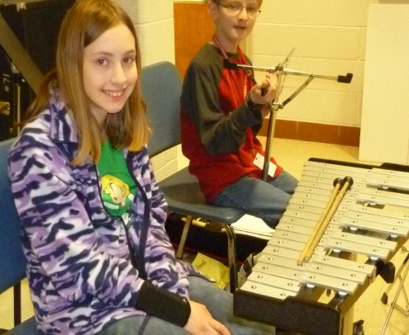
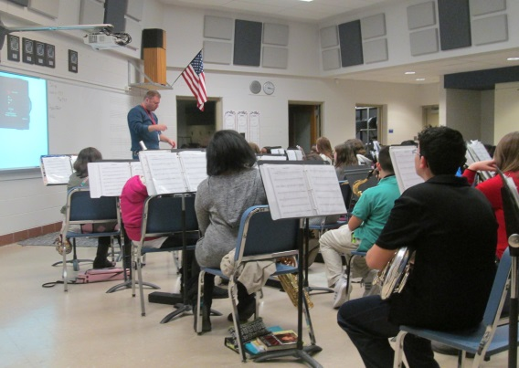
SIXTH GRADE ELECTIVE OPTIONS
(Path 1 – Band)
Woodwinds- saxophone, clarinet, flute, oboe, etc.
Brass- trumpet, trombone, French horn,
tuba, etc.
Percussion- drums, cymbals, etc.

Slide 8

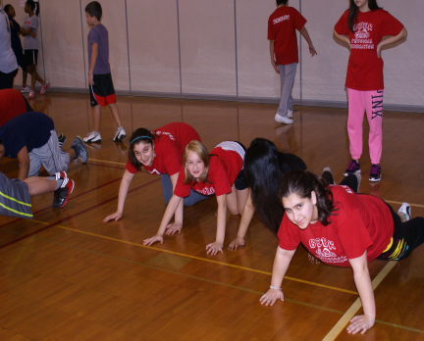

SIXTH GRADE ELECTIVE OPTIONS
(Path 2)
Choose two Semester electives:
Emerging Technologies I
Introduction to Coding
Team Sports
Spanish A/Spanish B
Choir
2D Art

Slide 9

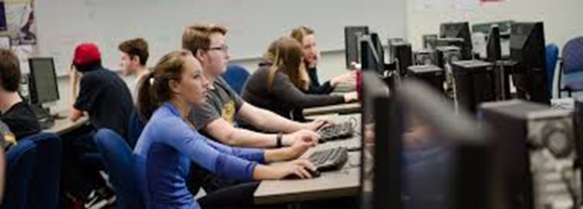
Offered in 7th and 8th grade as well
Emerging Technologies I
Essential skills covered include:
- Basic Orientation
- Typing Skills
- Digital Footprint
- Troubleshooting
- Cyber Safety
- Microsoft Imagine
Academy

Slide 10


Offered in 7th and 8th grade as well
Intro to Coding
Essential skills covered include:
- Introduction to Coding and
Computer Science
- Cyber safety
- Accountability
- Efficiency Within the Field
of Computer Science

Slide 11


Spanish A
Students will:
- build Spanish vocabulary
- develop basic conversation skills
- focus on Mexican culture
- also offered in 7th and 8th grade

Slide 12

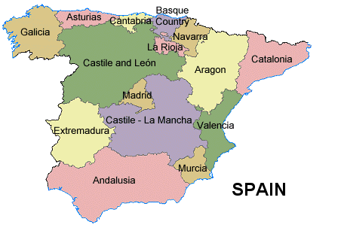
Spanish B
Students will:
- build Spanish vocabulary
- develop basic conversation skills
- focus on Spanish culture
- also offered in 7th and 8th grade
Spanish A & B are independent
of each other

Slide 13


CHOIR
Also offered in 7th and 8th grade
Vocal technique, sight reading, music theory, and music history
Semester

Slide 14
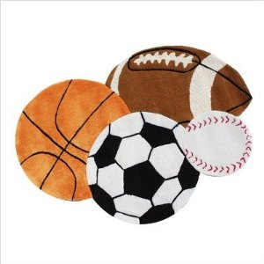

Team Sports
Students will focus on:
- categories of sport and activity
- progress in motor skills
- tactical knowledge unique to the
category of physical activity
Basketball, football, soccer,
volleyball, etc.
Also offered in 7th and 8th grade

Slide 15


ELA and Math Interventions

Slide 16

Placement into intervention classes is based on:
M-Step
NWEA
Historical grades
Reading/Math Readiness Exam

Slide 17

- be placed into a semester-long intervention class (in place of an elective).
- lunch academic intervention is available to all students
Based on our data analysis, students not yet proficient in the areas of English Language Arts and/or math may:

Slide 18
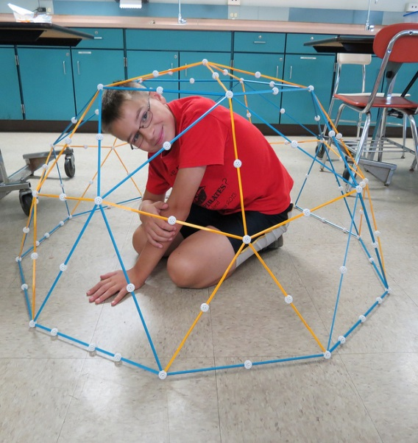
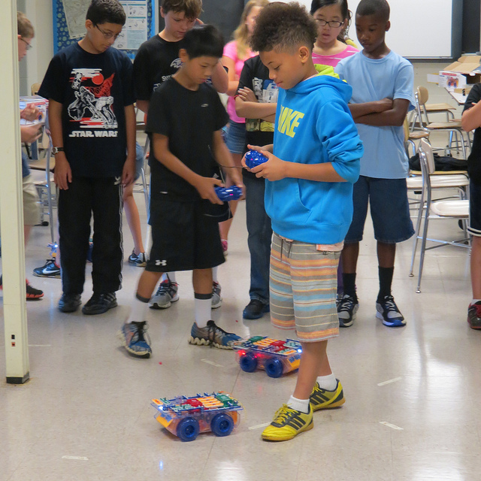
MS2TC/MSVPA
Letters are sent home to qualifying 5th graders through the Office of Curriculum and Instruction.
Letters include:
- Program details
- Information on testing
- application process and important dates
Math, Science, and ELA instruction for MS2TC students and Social Studies, ELA (1-hr), and an elective for MSVPA students occurs at Butcher for students who accept an invitation for enrollment

Slide 19

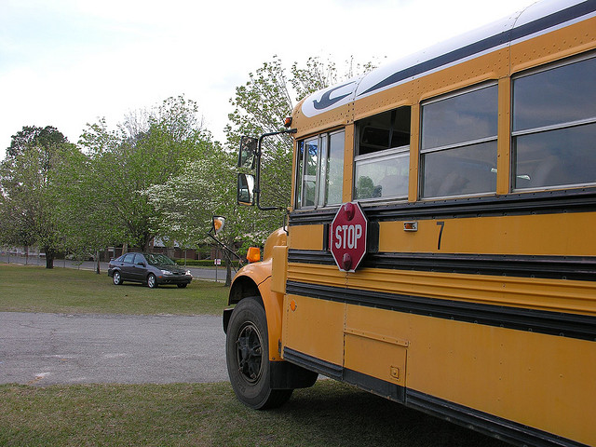
GENERAL BELL SCHEDULE
1st HOUR: 7:51 – 8:51
2nd HOUR: 8:55 – 9:55
3rd HOUR: 9:59 – 10:59
4th HOUR:
CLASS: 11:03 – 12:37
A Lunch: 11:03-11:33
B Lunch: 11:35-12:05
C LUNCH: 12:07- 12:37
5th hour: 12:41 – 1:41
6th hour: 1:45 – 2:45

Slide 20

Between Classes
Passing Time Expectations
There are 4:00 minutes between classes
Stop at your locker (Before 1st hour, between 3rd and 5th, and at end of the day.)
Use the restroom/check in with teacher if needed
Go to class

Slide 21
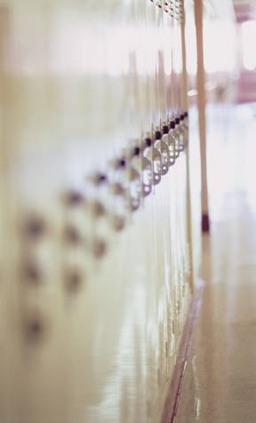
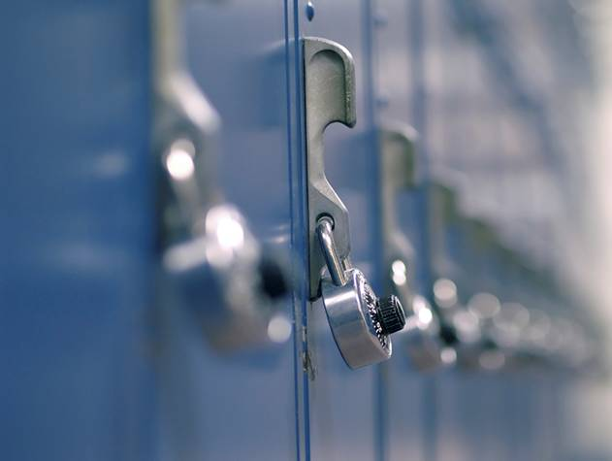
6th graders will be assigned a Locker
Remember your locker combinations for gym, band, and your regular locker.
Write it down and practice it so that you learn it quickly.
Never share your combination
This will be the locker for the duration of your time here at BMS

Slide 22

Beer Middle School
HONORS
Quarterly All A Honor Roll
No 3’s in citizenship
Quarterly Honor Roll
3.0 or above GPA (No C’s, D’s or F’s)
No 3’s in citizenship

Slide 23

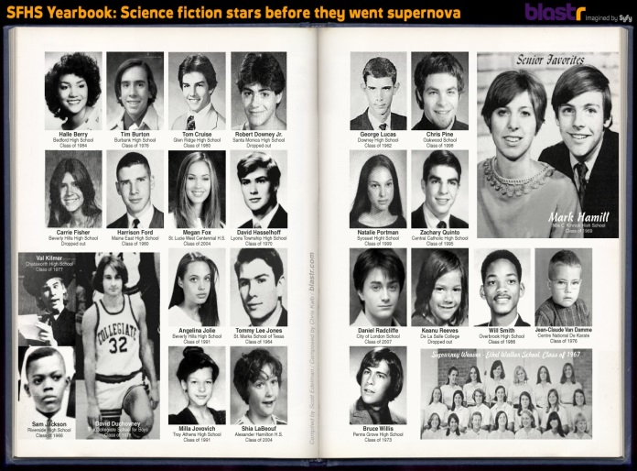
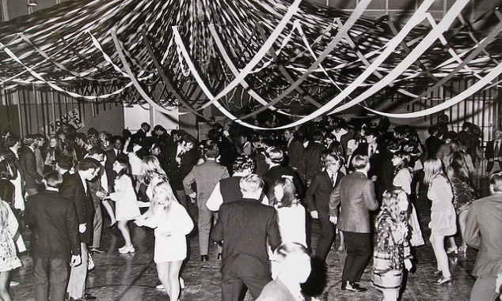
EXTRACURRICULAR
ACTIVITIES
Ecology Club
Yearbook
WEB (Where Everyone Belongs) Leaders
SAC (Student Activities Council)
These clubs are open to all grades

Slide 24



BARON
ATHLETICS
In 7th and 8th grade, students may be involved in athletic activities:
Boys Football
Girls Volleyball
Boys & Girls Basketball
Boys & Girls Track and Field

Slide 25
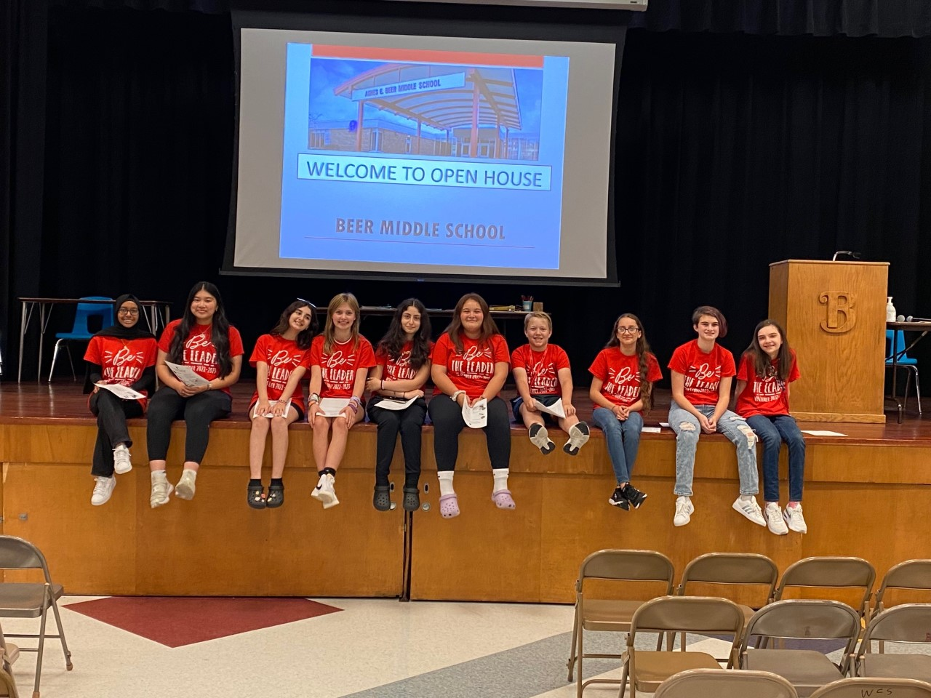
Where
Everyone
Belongs
Transition program for incoming 6th graders
8th graders act as student mentors to 6th graders
WEB Leaders encourage 6th graders to participate in social and academic activities throughout the school year

Slide 26
Security Guard Duties
Hallways during class time
School dress code
Cell phone policy
Bathrooms
Café
Locker Rooms

Slide 27
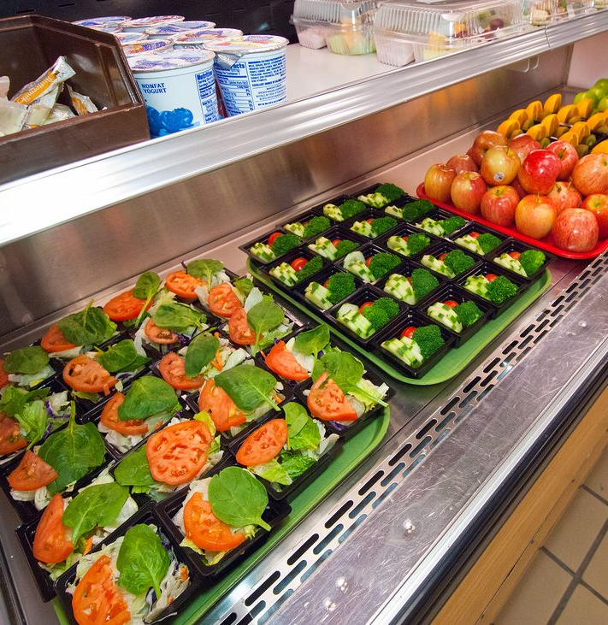
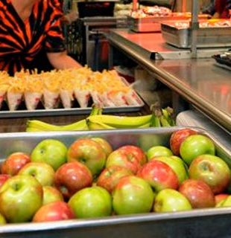
Cafeteria

Slide 28
Beer Boosters, Q&A, Band Fittings, Self-Guided Tour
Beer Boosters
All are welcome to stay for questions & answers.
Self-Guided Tour of BMS
All incoming Band Students and Parents, please go to the Band Room for a presentation from A&G Music and instrumental fitting.

