Slide 1
BEER MIDDLE SCHOOL
Course Selections
2023 - 2024

Slide 2

Sixth Grade
REQUIRED ACADEMIC COURSES
40 WEEKS EACH
Language Arts – 2 HOUR BLOCK
Math Course 1 or Math Course 2 by placement
Science 6
Social Studies 6

Slide 3


Sixth Grade
ELECTIVE COURSES
40 Weeks Total
OPTION 1: Band for 40 weeks.
OPTION 2: Two 20-week electives.

Slide 4
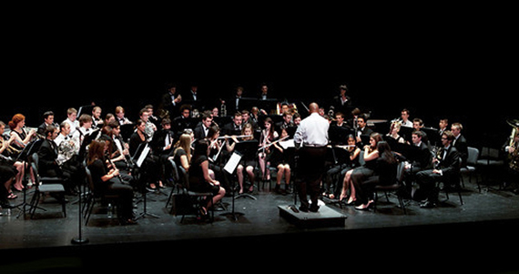
6th BAND – 40 WEEKS
Further development of skills toward mastery of their instrument.
Performance attendance and activity participation is required.

Slide 5

2-Dimensional Art – 20 WEEKS
Introduces elements and principles of art through history and culture.
Two-Dimensional Art forms will be explored.
  Pencil and pastel drawing
  Acrylic and watercolor painting
  Printmaking
  Silk painting
Same class offered in 8th grade

Slide 6
Engineering and the Environment – 20 WEEKS
Students will engage in hands on activities that utilize their reasoning and problem-solving skills to discover the science behind the technology of alternative, sustainable, and renewable energy sources, including alternative fuels like fuel cell cars, ethanol, bio-fuels, solar, hydro, and wind power.
Offered in 8th grade

Slide 7

Engineering for the Future – 20 WEEKS
In this course, students will discover the science and technology needed to create, design, and manufacture different structures and machines.
Use problem solving to learn about:
  Simple machines
  Bridges
  Skyscrapers
  Robotics
  Rocketry
Offered in 8th grade

Slide 8


CHOIR
20-week class
Vocal technique, sight reading, music theory, and music history
Offered in 7th and 8th grade

Slide 9


Emerging Technologies I
Essential Skills covered in this class are:
  Basic Orientation
  Typing Skills
  Digital Footprint
  Troubleshooting
  Cyber Safety
  Microsoft Imagine Academy
Offered in 7th and 8th grade

Slide 10
Spanish A – 20 Weeks
Only for students who did not take Spanish A in 6th grade.
This course, with a Mexican cultural emphasis, will develop the student’s speaking, reading, and writing of the Spanish Language.

Slide 11
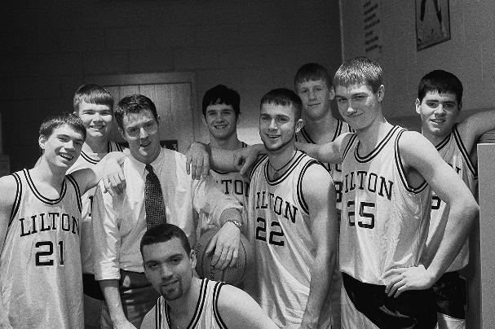
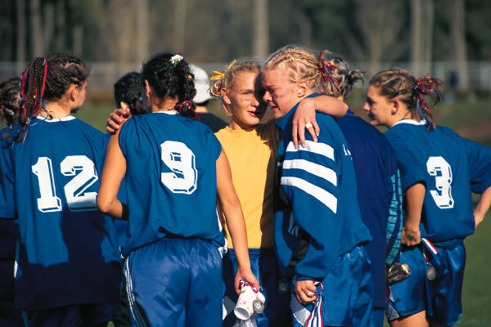
Team Sports – 20 WEEKS
This course focuses on categories of sport and activity, progress in motor skills and tactical knowledge unique to that category of physical activity.
Combining basic elements of movement and sports are emphasized in this course.
Similar course required in 8th grade called Fitness for Life

Slide 12
Sixth Grade
Reading or Math Intervention classes
It may replace one of your elective courses
Placement Test Results
M-Step Scores
NWEA Scores
Academic Grades

