Slide 1
2022-2023 Virtual Student Scheduling Only

Slide 2
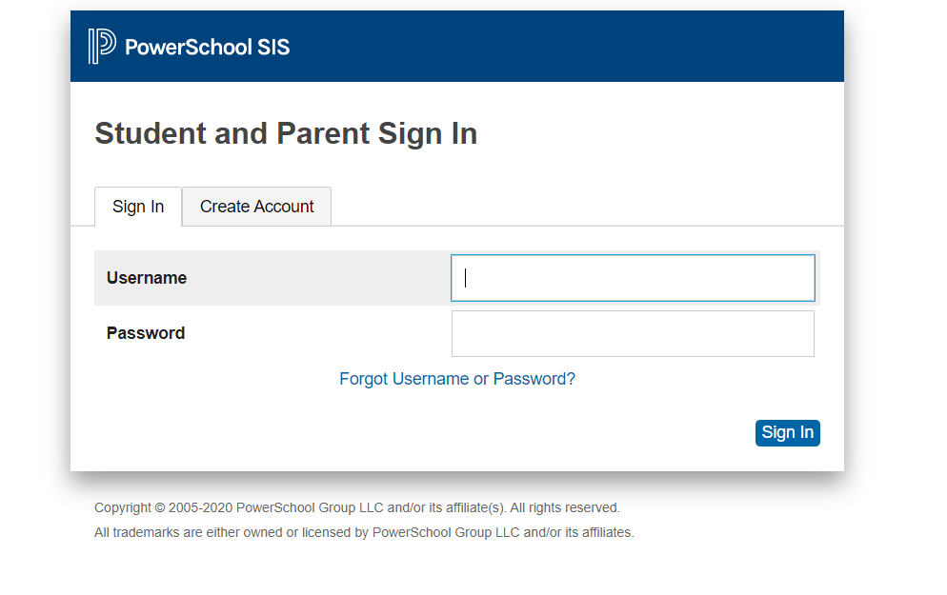
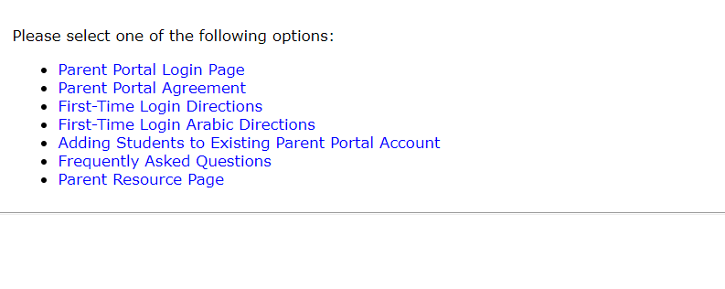
Online Scheduling for ALL students
1^{st STEP}
Go to www.wcskids.net
Parents/Students
Quick Links
Parent Portal/PowerSchool
6 digit student number
Password for everything

Slide 3
Parent Portal/PowerSchool
ALL CORE CLASSES (MATH/ ELA/ SCIENCE/ SOCIAL STUDIES) HAVE BEEN ADDED FOR YOU
AND
If you qualify you may see math builder/ELA builder already loaded.

Slide 4
SELECTING ELECTIVES
You may only choose a certain number of electives for example:
DO NOT CHOOSE A CLASS YOU HAVE ALREADY HAD
6th grade=4
7th grade=4
8th grade=3 because you HAVE to take Fitness for Life
Click here to see your options

Slide 5
ELECTIVE ALTERNATES
Once you choose your 4 favorite electives please go down to the next box and choose 2 additional electives you have not had. This allows us to use these options if we can’t get you your first choices.

Slide 6
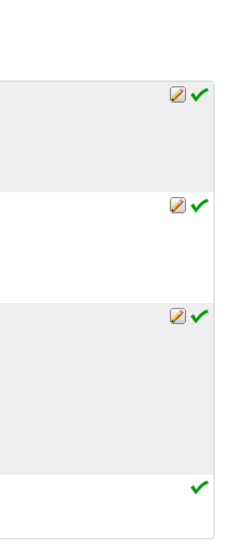
How do you know you have completed your scheduling?
You will see these green check marks!

Slide 7
Questions?
As always, please come to see Ms. Hill or Mr. Kay if you or your parents have any questions.
You can reach us through Counselor Connection on Schoology
OR
Ms. Hill
bhill@wcskids.net
Office Phone: 586-698-4279
https://wcskids.webex.com/meet/bhill
Mr. Kay
rkay@wcskids.net
Office Phone: 586-698-4280
https://wcskids.webex.com/meet/rkay

